Slide 1
Memory Management Unit for Embedded RRAM – UPDATE [1]
by
Shikhar Tuli
Under the guidance of Dr. Alexandre Levisse
Embedded Systems Laboratory, EPFL

Slide 2
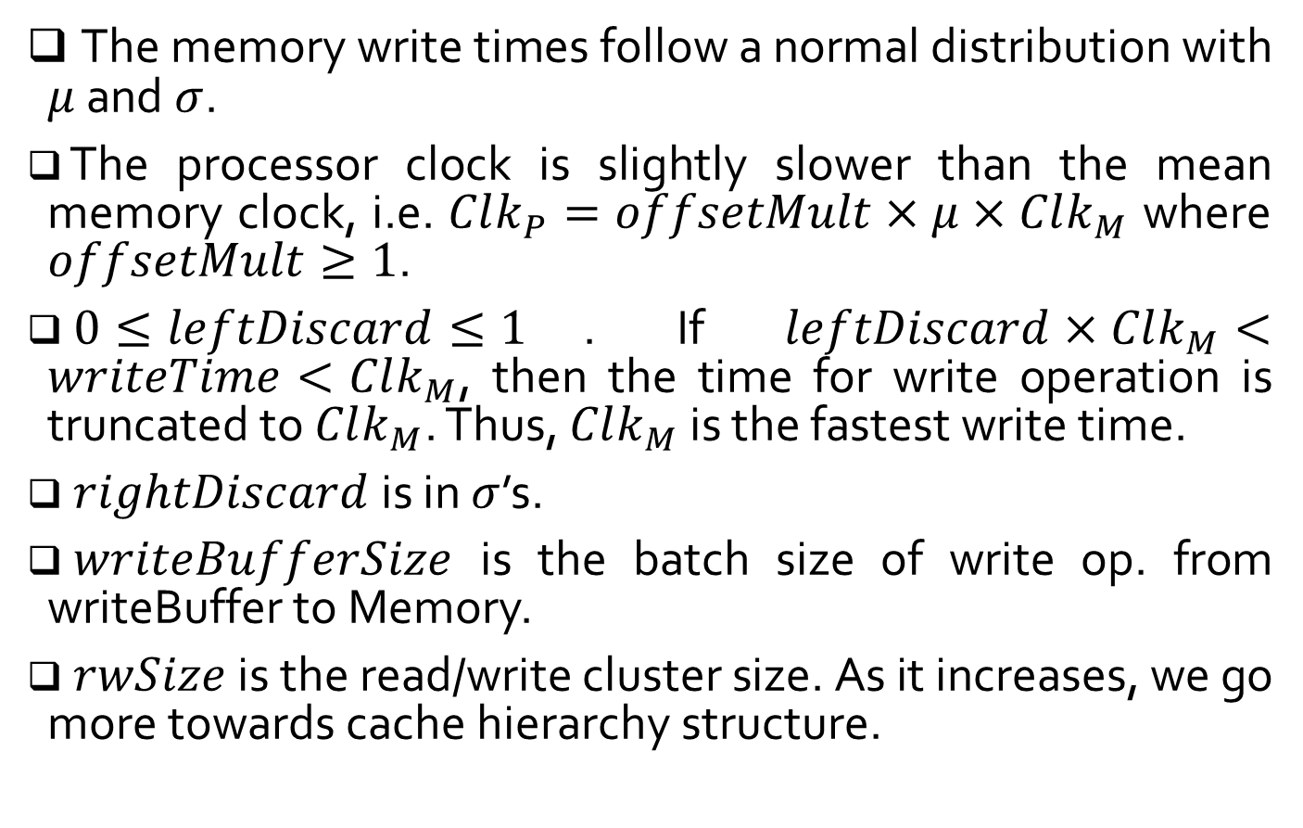
Definitions
The memory write times follow a normal distribution with $μ$ and $σ$.
The processor clock is slightly slower than the mean memory clock, i.e. $Clk_{P}=offsetMult×μ×Clk_{M}$ where $offsetMult≥1$.
$0≤leftDiscard≤1$. If $leftDiscard×Clk_{M}<writeTime<Clk_{M}$, then the time for write operation is truncated to $Clk_{M}$. Thus, $Clk_{M}$ is the fastest write time.
$rightDiscard$ is in $σ$’s.
$writeBufferSize$ is the batch size of write op. from writeBuffer to Memory.
$rwSize$ is the read/write cluster size. As it increases, we go more towards cache hierarchy structure.
#2

Slide 3
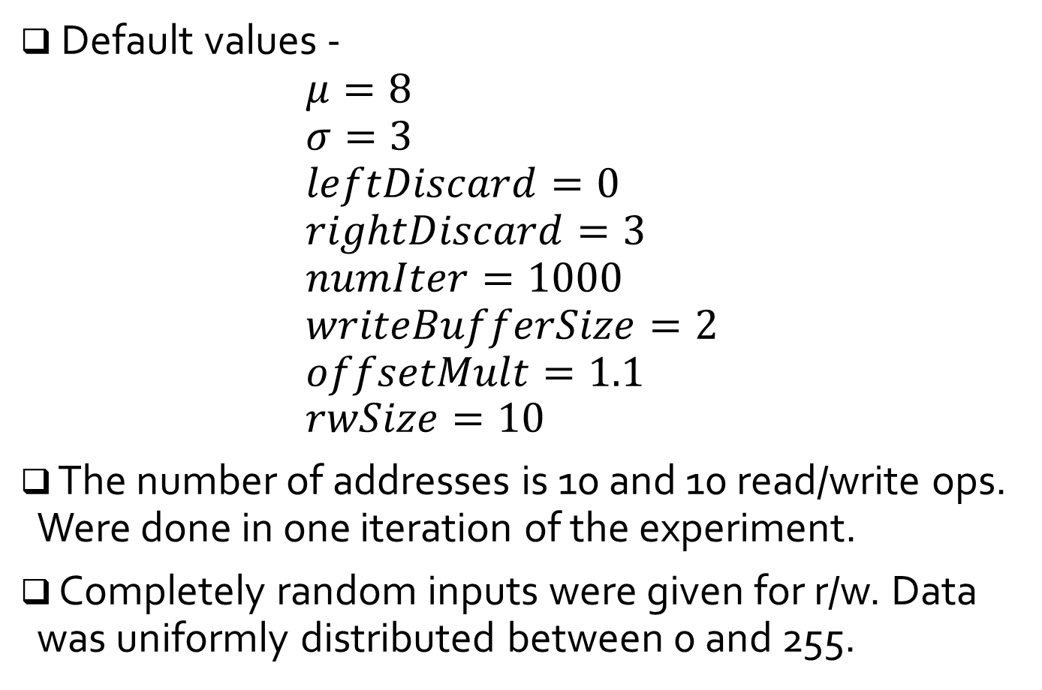
Definitions (contd.)
Default values - $μ=8$ $σ=3$ $leftDiscard=0$ $rightDiscard=3$ $numIter=1000$ $writeBufferSize=2$ $offsetMult=1.1$ $rwSize=10$
The number of addresses is 10 and 10 read/write ops. Were done in one iteration of the experiment.
Completely random inputs were given for r/w. Data was uniformly distributed between 0 and 255.
#3

Slide 4


Observations
$offsetMult$ varied from $1$ to $2$. Only write ops. (i.e. $rwSize=10$). Parallel write considered.
No variability due to deterministic r/w ops in reference. All parallel operations take $writeBufferSize×\left(μ + rightDiscard×σ\right)× Clk_M$
#4

Slide 5


Observations (contd.)
$offsetMult$ varied from $1$ to $2$. Only write ops. (i.e. $rwSize=10$). Serial write considered.
Non-monotonic behavior in reference. With increasing $offsetMult$, the write times should increase, more-or-less monotonically. Also, write times of proposed should always be $≤$ that of ref.
#5

Slide 6

Observations (contd.)
$writeBufferSize$ varied from $1$ to $10$. Only write ops. (i.e. $rwSize=10$). Parallel write considered.
With increasing batch size, the write times are increasing.
#6

Slide 7

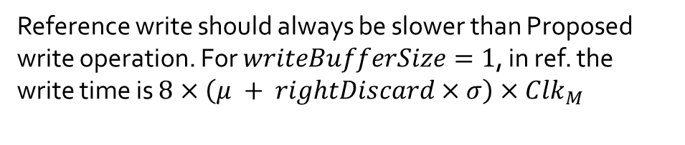
Observations (contd.)
$writeBufferSize$ varied from $1$ to $10$. Only write ops. (i.e. $rwSize=10$). Serial write considered.
Reference write should always be slower than Proposed write operation. For $writeBufferSize=1$, in ref. the write time is $8×\left(μ + rightDiscard×σ\right)×Clk_{M}$
#7

Slide 8

Observations (contd.)
$rwSize$ varied from $2$ to $10$. Parallel write considered.
Can’t find trend in non-monotonic behavior. Proposed always faster than Reference.
#8

Slide 9

Observations (contd.)
$rwSize$ varied from $2$ to $10$. Serial write considered.
Can’t find trend in non-monotonic behavior. Proposed always faster than Reference.
#9

Slide 10
Observations (contd.)
0 to 255 write operation. Comparison between proposed and reference for both 0-255-0 and 0-0 operations (Parallel)
0-255-0
0-0
#10

Slide 11
Observations (contd.)
0 to 255 write operation. Comparison between proposed and reference for both 0-255-0 and 0-0 operations (Serial)
0-255-0
0-0
#11

Slide 12
Thank you
#12

